Slide 1
Use Cases and
Activity Diagram
Session 20
(Tutorial)
Course : Program Design Methods
Effective Period : July 2018

Slide 2
These slides have been adapted from
Britton, C.. (2005). A student Guide to Object Oriented Development. 01. Butterworth-Heinemann. Amsterdam. ISBN: 978-0-7506-6123-2.
Chapter 3 & 8
Acknowledgement

Slide 3
LO 5 : Explain the object oriented design
Learning Objectives

Slide 4
Contents
Use Case Diagram
Use Case Description
Actors and Actor Description
Use Case Relationship; communication association, include and extend
Boundary
Activity Diagram
Modelling iteration of activities
Modelling activities that are carried out in parallel
Activity Swimlanes

Slide 5
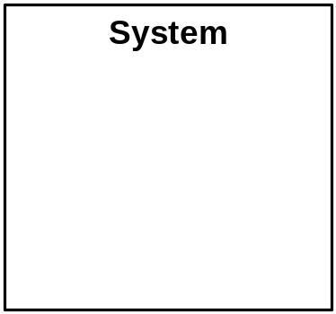
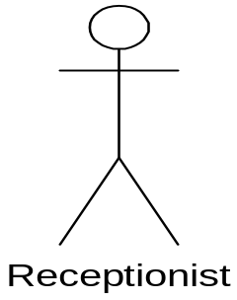
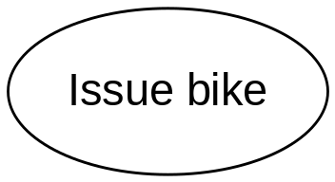
Use Case Diagram
A Use case : an
ellipse labeled
with the name
of the use case
An actor : a stick
figure labeled
with the name of
the actor. The
stick figure icon is
used even when
the actor is non
human, e.g an
organization
A use case
relationship : a
line linking an
actor to a use
case. This
relationship is
also known as a
Communication
association
The boundary : a
line drawn round
the use cases to
separate them
from the actors
and to delineate
the area of
interest

Slide 6
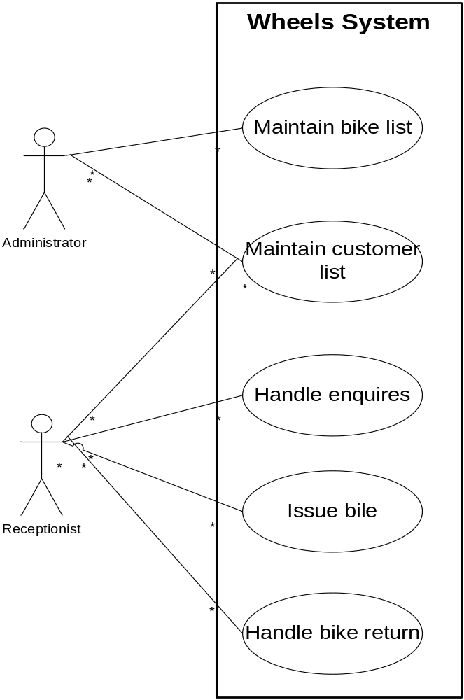
Example
The functionality of the new system has been divided into five use cases :’Maintain bike list’, ‘Maintain customer list’, ‘Handle enquires’, ‘Issue bike’, and ‘Handle bike return’
The actor, represented by a stick figure, is the person who uses the system in the way specified in the use case

Slide 7
The Use Case
There are two ways of identifying the use case
  Identifying use cases from the actors (Example)
    Identify the actors, the users of the system, and for each one, to establish how they use the system, what they use it to achieve :
    Annie and Simon start off by talking about issuing bikes. Issuing bike involve finding a suitable bike, calculating the hire charge, collecting the money, issuing a receipt and recording details of the customer and the hire transaction

Slide 8
The Use Case
  Identifying use cases from scenarios (Example)
    Scenarios describes a series of interactions between the user and the system in order to achieve a specified goal. A scenario describe a specific sequence of events.
Stephanie arrives at the shop at 9.00am one Saturday and choose a mountain bike
Annie sees that its number is 468
Annie enters this number into the system
The system confirms that this woman’s mountain bike and displays the daily rate (£2) and deposit (£60)
Stephanie says she wants to hire the bike for a week
Annie enters this and the system display the total cost £14 + £60 = £74
Annie enter Stephanie’s name, address and telephone number into the system
Stephanie pays the £74
Annie record this on the system and the system prints out a receipt
Stephanie agrees to bring the bike back by 9.00am on the following Saturday

Slide 9
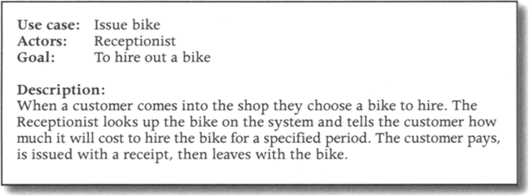
Use case descriptions
High Level Description:

Slide 10
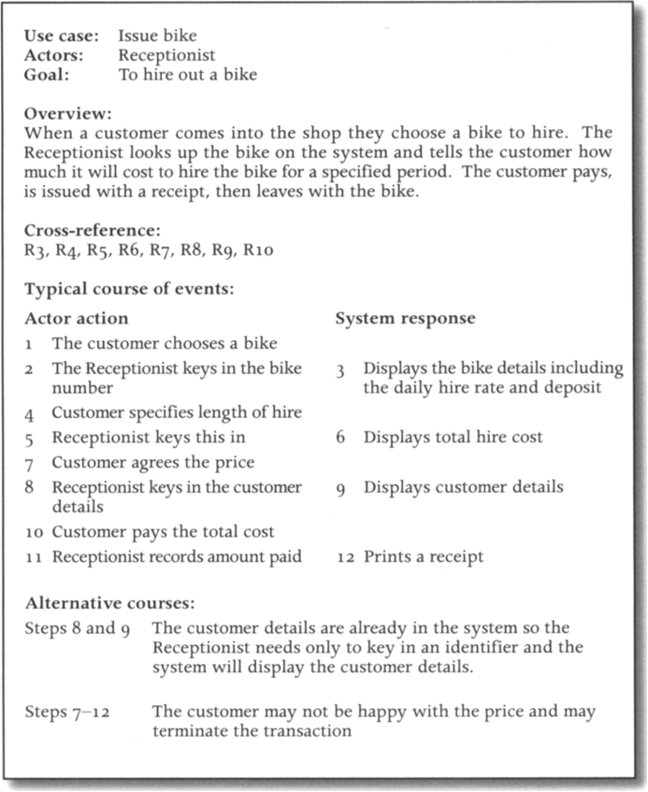
Use case descriptions
Expanded Description

Slide 11
Actor and Actor description
Example :
  The Receptionist uses the system to answer queries about bike availability and cost, to issue a bike for hire and to register a bike return. The receptionist can be the shop manager, any of the mechanics or the owner
  The Administrator uses the system to maintain lists of customers and bikes. The administrator can be the head mechanic , the shop manager or the owner

Slide 12
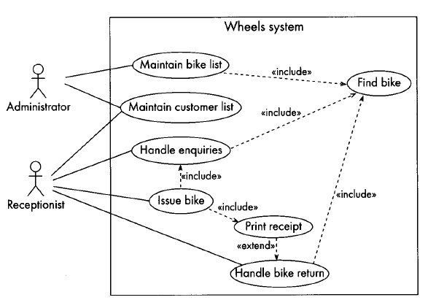
Use Case relationship example include and extend

Slide 13
Boundary
Boundary
  It is shown as a line round the use cases, separating them from the actors, normally it is labaled with the name of the system or subsystem.

Slide 14
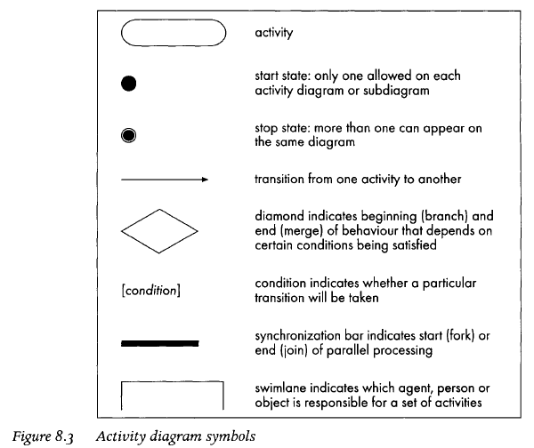
Activity Diagram

Slide 15
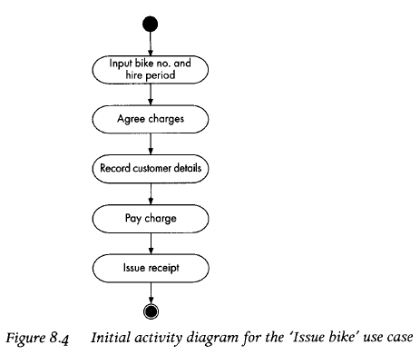
Activity Diagram

Slide 16
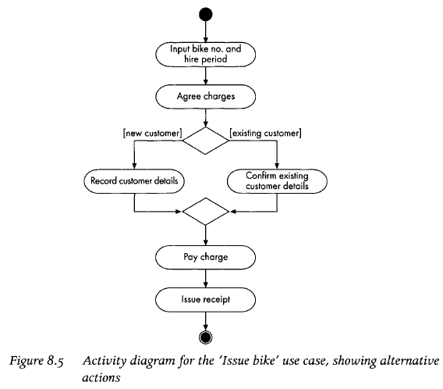
Activity Diagram

Slide 17
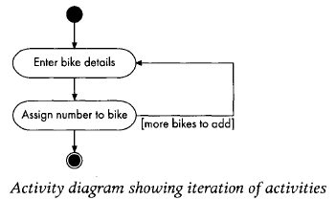
Modeling Iteration Activities

Slide 18
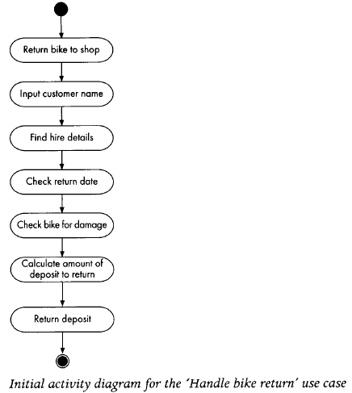
Initial Activity Diagram

Slide 19
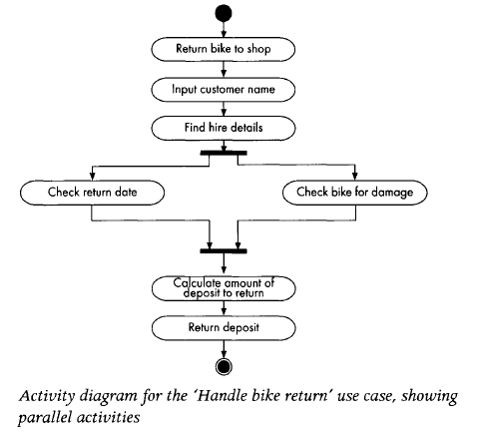
Modeling activities that are carried out in parallel

Slide 20
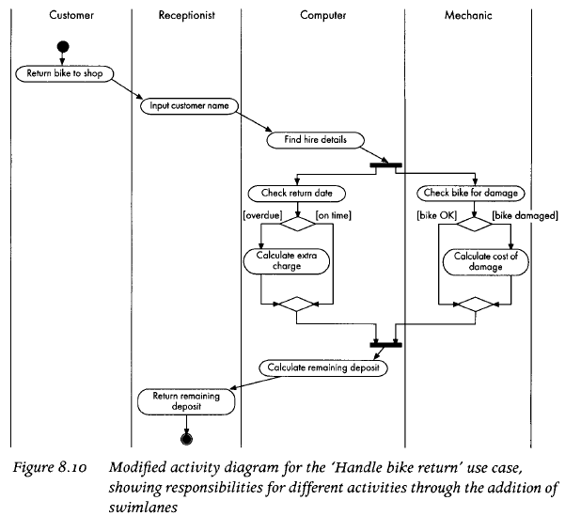
Activity Swimlane

Slide 21
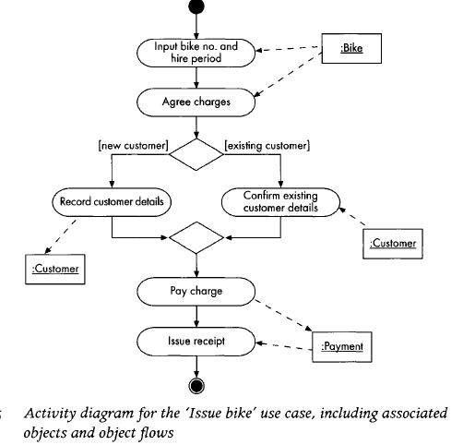
Technical Point

Slide 22
References
Britton, C.. (2005). A student Guide to Object Oriented Development. 01. Butterworth-Heinemann. Amsterdam. ISBN: 978-0-7506-6123-2.
Use Case Diagram, http://www.objectmentor.com/resources/articles/usecases.pdf
Activity Diagram, http://www.agilemodeling.com/artifacts/activityDiagram.htm
UML, http://www.apl.jhu.edu/Classes/Notes/Demasco/605704/UMLIntroduction.pdf

Slide 23
Q & A

Slide 24
Exercise
Once you have got a basic set of use cases reflecting the main tasks in the system, what might make you decide to create a new use case linked to one of the basic use cases by an <<include>> relationship?
Under what circumstances would you consider creating a new use case and linking it to an existing use case with an <<extend>> relationship?

Slide 25
Exercise
The owners of a small retail company make regular orders to their supplier. First, they check their current stock, and then compile the order. When they receive the goods, they check them against the order, and update stock levels. They also pay the supplier’s bill. Draw an activity diagram to illustrate the ordering process. Your diagram should include an example of parallel processing.

